Slide 1
Cancellation status of Hotel Booking by using ML Classifiers
By
BH Kushwanth
119EC0001

Slide 2
Agenda
Problem statement
Given data
Visualization
Steps we have done
Choosing best fit Model
Conclusion

Slide 3
Problem statement:
Hotel Booking Cancelation prediction Problem
Type: Binary Classification Hotel booking cancelation prediction is classic problem to learn and apply lots of data analysis techniques to create best Classification model.
Given with the dataset consisting of details of applicants for hotel booking and status whether the booking application is approved or not. Basis on the a binary classification model is to be created with maximum accuracy.

Slide 4
Given Data:
Number of hotels booking Cancelled (Data Set) and Data types.

Slide 5
Data Set Details:
Dataset that we use in this problem is “hotel_bookings”. In this dataset there are vast number of observations and features/variables. Size of the dataset is 1,19,390*32. These are of different datatypes. Variables are classified as follows.
object – hotel, arrival_date_month, meal,country, market_segment,distribution_channel, reserved_room_type,assigned_room_type , deposit_type, customer_type, reservation_status, reservation_status_date .
float – adr, agent, company, chidren
int - is_canceled, lead_time, arrival_date_year, babies, is_repeated_guest, previous_cancellations, previous_bookings_not_canceled, booking_changes, days_in_waiting_list, required_car_parking_spaces, total_of_special_requests.

Slide 6
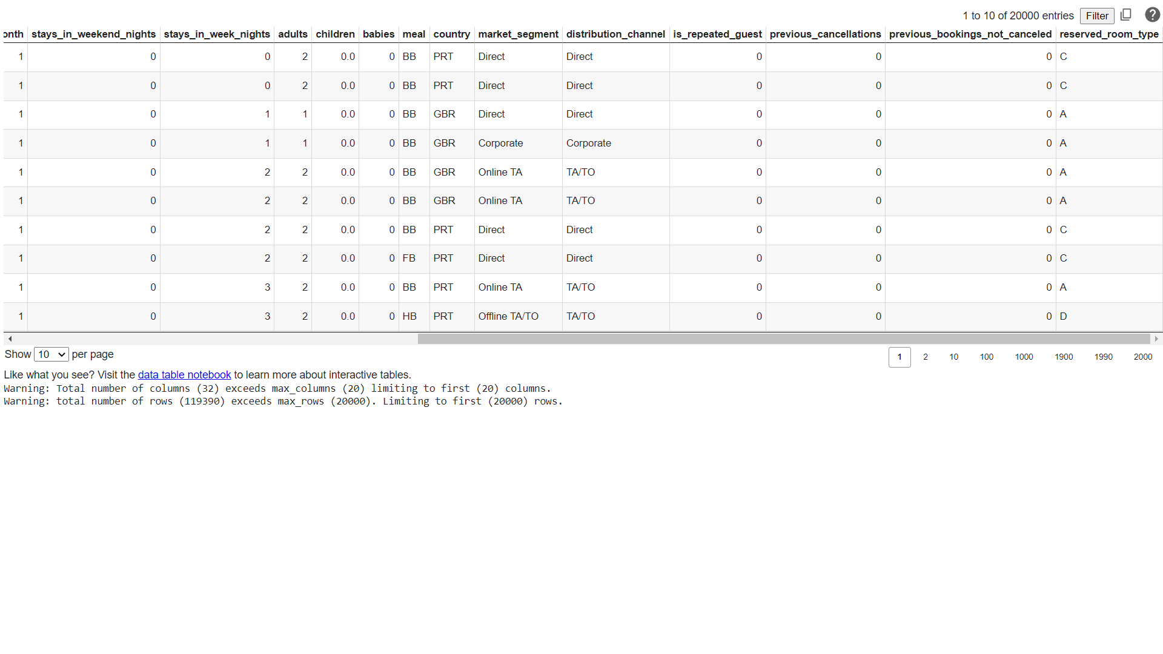
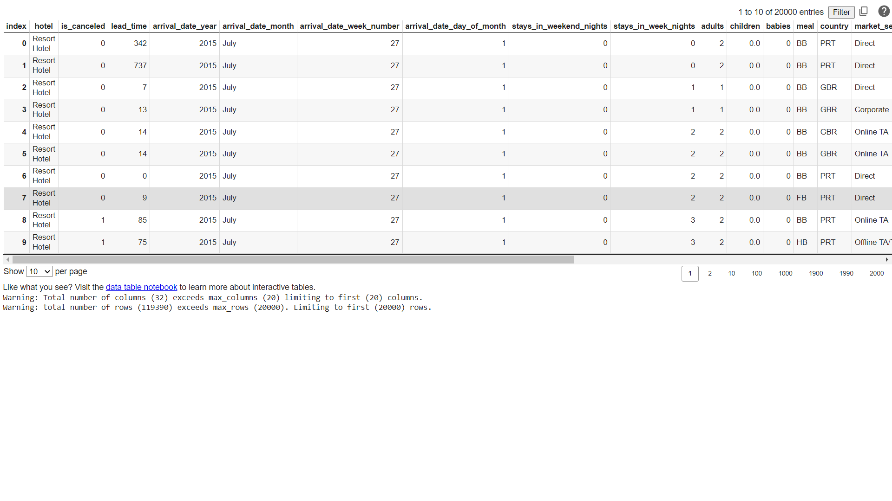
Data set Table:
Link : "https://raw.githubusercontent.com/Premalatha-success/Datasets/main/hotel_bookings.csv"

Slide 7
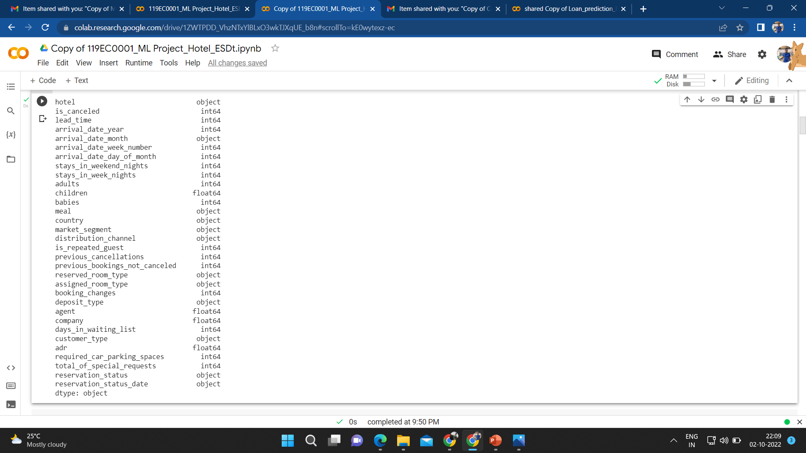
Data Types:

Slide 8
Visualization With Inference
“
”

Slide 9
Data Visualization:
By visualizing data we can explore data in more detailed way. Data can be visualized in various formats such as bar graphs, scatterplot, plotting, pie charts, histograms, boxplots, heatmaps.
In this project we visualize data using heatmaps, bar charts and scatterplots in order to get details of different variables.
Heatmaps are used to find the null values in the data set. In other words, to find columns which contains null values. From this graph we could able to remove the columns easily which have more null values. Heatmaps are also used for showing confusion matrices and correlation matrix.
Scatter plot helps to show the relation between 2 variables.
Bar charts are used to visualize the dependent variable with respect to categorial data in data frame.

Slide 10
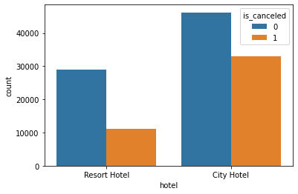
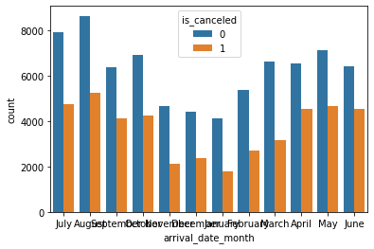
Visualizing feature to feature:
figure1: Bar chart with Hotel_type on x-axis and count of is canceled on y-axis
figure2: Bar chart with arrival date month _type on x-axis and count of is canceled on y-axis

Slide 11
Data Visualization:
figure1 represents bar chart between the independent variable Hotel type and target variable is_canceled. Inference from this graph is City hotel is more involved in canceling bookings comparative to Resort hotel.
figure2 represents bar chart between the independent variable Arrival_Date_Month type and target variable is_canceled. Inference from the graph is In the month of august the cancelation of bookings is more comparative than in the month of January.

Slide 12
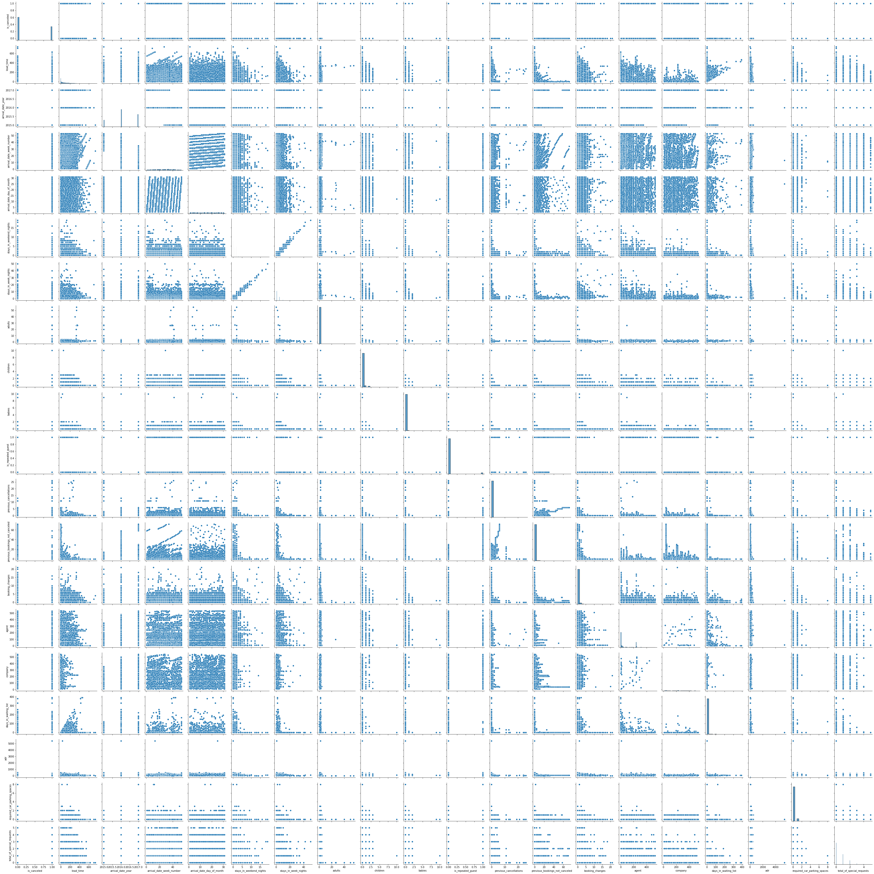
The Pair Plot:
Pair plot between all the numerical data type variables. This graph helps us to understand the relation of a variable with all the other variables.

Slide 13
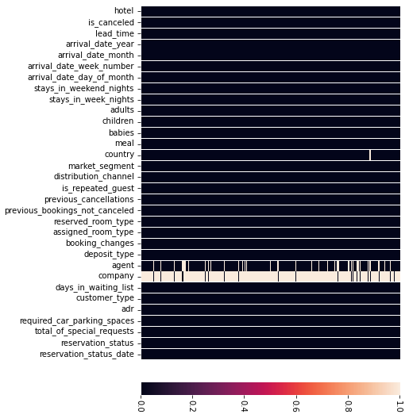
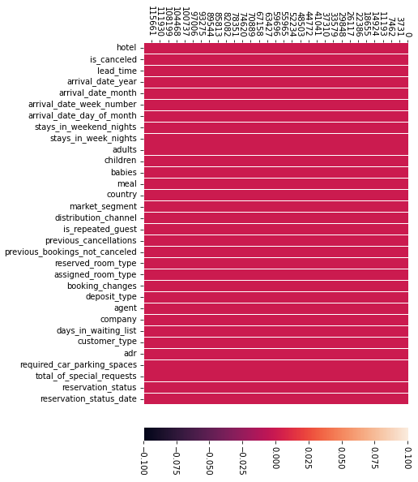
visualizing null values:
Figure 3: heatmap showing white lines for null values
Figure 4: Heatmap after filling missing values

Slide 14
Data Visualization:
figure 3 is a heatmap created to find the missing values in the dataset. From the graph, we can analyze that there are more missing values in the company column. Next, column agent has more null values after company column. Comparatively there are less null values in column country. In column children there are very few null values which cannot be found in the graph and can be found using other commands.
figure 4 Represents heatmap after pre-processing the dataset which means after filling the null values with median and mode values.

Slide 15
Steps we have done:
Step 1: Importing Libraries
First step is to import all the required libraries and models such as pandas, numpy, matplotlib, seaborn, sklearn, train _test_split, LogesticRegression, K- Nearest Neighbors, confusion_matrix, accuracy_score, Decision Tree classifier , f1_score, LabelEncoder.
Ignoring warnings using warnings class.

Slide 16
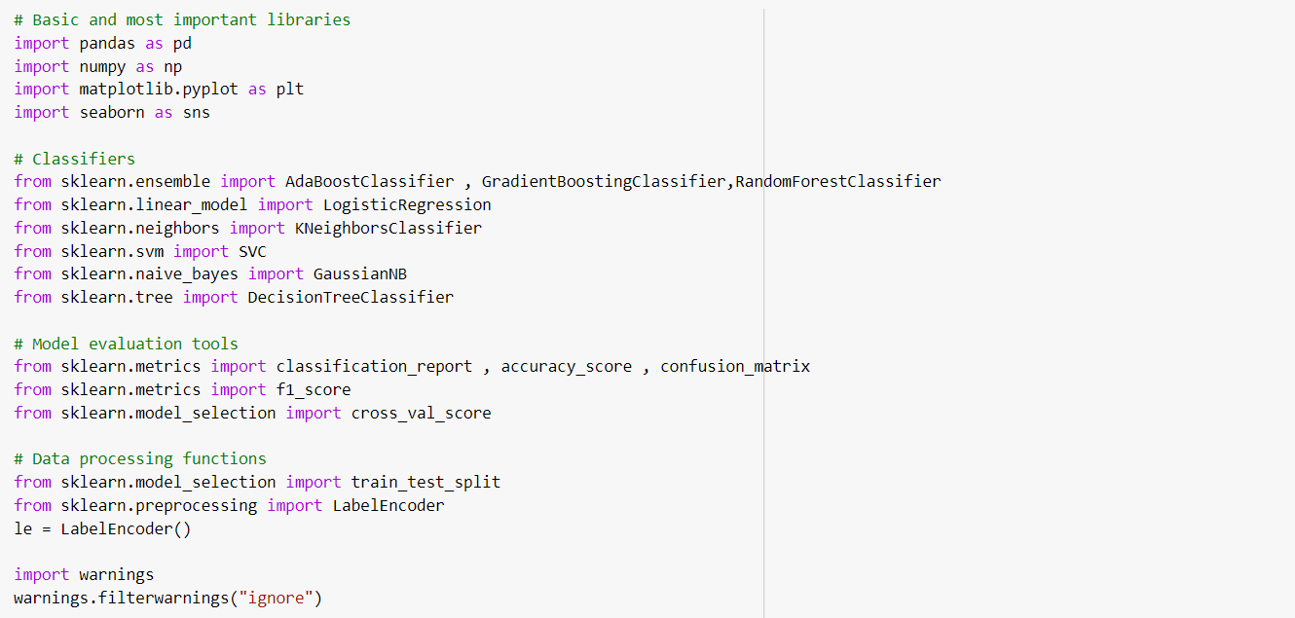
Step 1: Importing Libraries

Slide 17
Steps we have done:
STEP 2: Loading and Analyzing data
Loading dataset to a variable(data) in the form of dataframe using pd.read_CSV() command.
Analyze shape, datatypes and statistical information of the dataset using commands such as data.shape, data.dtypes, data.describe(), data.info().

Slide 18
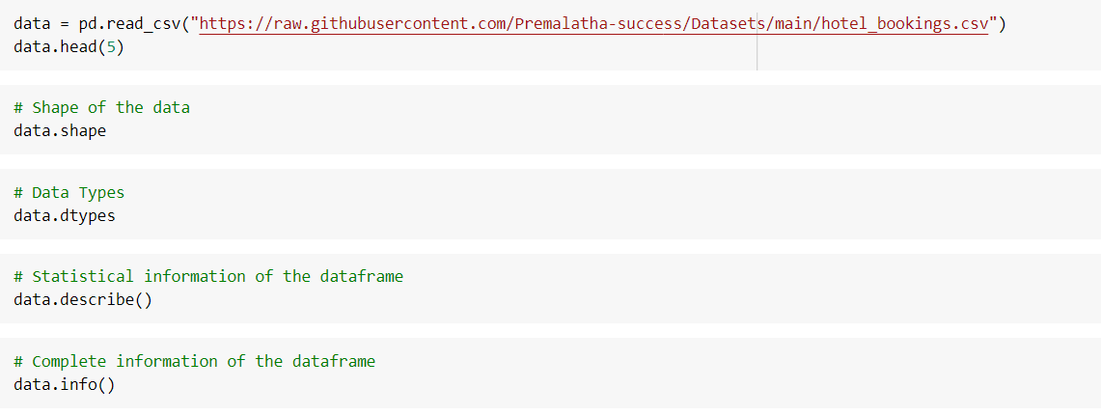
Step 2: Analyzing Data

Slide 19
Steps we have done:
STEP 3: Data Visualization
This is a major step while implementing a model as I have already mentioned in the previous slides.
In this we initially plot graph between categorial variables such as Hotel type, Customers Arrival date Month type and target variable is_canceled.
After that we plot a heatmap graph for the correlation matrix of the given dataset to find the variables which are more related to each other. We use sns.heatmap (data.corr()) command for doing this.
Finally we draw a pair plot to find relation among all the numerical variables in the dataset.
These visualization steps are taken before the actual implementation in order to analyse the data in detail.

Slide 20
Steps we have done:
STEP 4: Data Pre-processing
Now before going to implement a model we have to clean the data. Data cleaning process involves handling with missing data, duplicate data, noise and outliers.
Using heatmap and data.isnull().sum() command we will find the missing values in the given dataset. After that we will fill the missing values with median for the numerical data and with mode for categorial data. For it we use fillna() or replace() command. Then we go for removing duplicates and outliers if needed.
After completing the cleaning process we again go for verification of missing values in dataset using heatmap.

Slide 21
Step 4: Data pre processing
#visualizing null values
plt.figure(figsize=(10,6))
sns.heatmap(data.isnull(),yticklabels=False)
# Replace Null values with median for int and float and mode for object type
data["country"].fillna(data["country"].mode()[0],inplace=True)
data["agent"].fillna(data["agent"].median(),inplace=True)
data["company"].fillna(data["company"].median(),inplace=True)
data["children"].fillna(data["children"].median(),inplace=True)
#veryfing the null values
print(data.isnull().sum())
#visualizing null values
plt.figure(figsize=(10,6))
sns.heatmap(data.isnull())

Slide 22
Steps we have done:
STEP 5: Encoding Categorial Data
After data pre-processing data, next step is to create dummies for categorial data using fit.transform() command.
This step enables the model to perform more accurately by including categorial data.
We an also use pd.get_dummies() command for the same purpose.

Slide 23
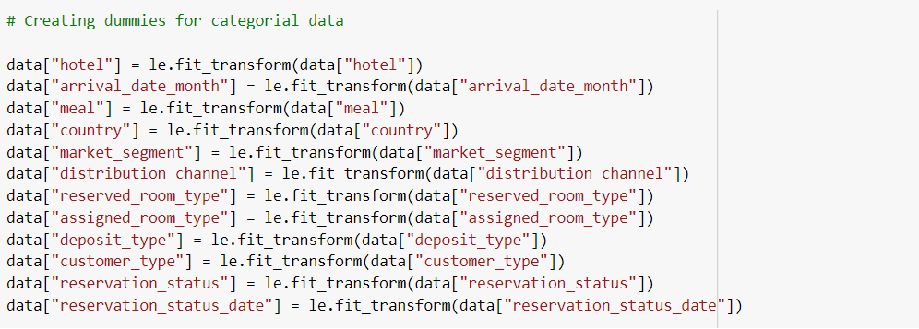
Step 5: Encoding Categorial Data

Slide 24
Steps we have done:
STEP 6: Splitting Data into Input X Variable and Target y variables
Now we have to split the data as per the problem statement. For this problem statement we should split ‘is_canceled’ as target variable/dependent y variable and other independent variables as Input X variable .
STEP 7: Implementing Model
Finally after completion of all the other processes we have to implement the classifier models and should choose the best fit model by using score and accuracy parameter.

Slide 25
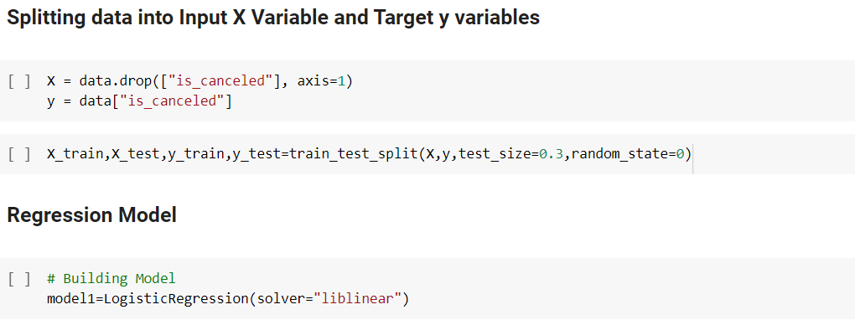
Steps 6 & 7: Splitting and Creating model

Slide 26
Choosing Best Model: Decision Tree
Why?
Here I tried Three of the Machine Learning Algorithms such as Logistic Regression, K-Nearest Neighbors & Decision Tree Algorithms.
But Finally I have chosen Decision tree model because the accuracy rate of this algorithm is 100%

Slide 27
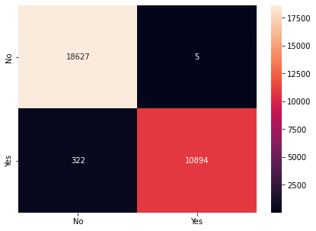
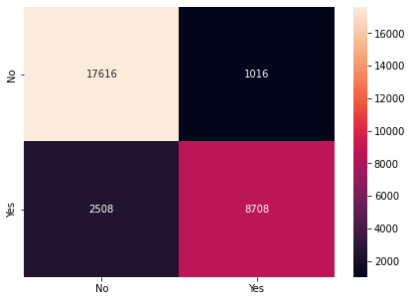
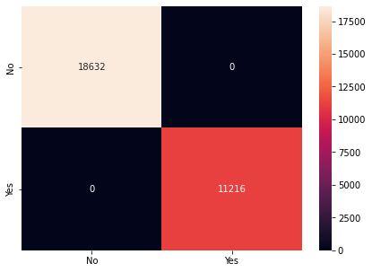
Confusion Matrices of Classifiers:
Logistic Regression
K-Nearest Neighbors
Decision Tree

Slide 28
Conclusion:
In this project we used three Machine learning classification algorithms to know the cancellation status of hotel rooms by using given data set.
After the visualization of features in the data set by using training data and testing data we come to know among the three algorithms the accuracy rate & precision is different they are –
Logistic regression:
Training Data: 0.9899823546492149
Testing data:0.9890444920932726
KNN:
Training Data:0.9209979674342766
Testing data:0.881935138032699
Decision Tree:
Training Data: 1.0
Testing Data: 1.0
So, we come to know that Decision Tree model classifier is working more accurate in booking of services from Hotel.

Slide 29
Thank you
BH. Kushwanth
119EC0001

